Slide 1
JDBC part 2
Algoritma dan Pemrograman II

Slide 2
Bobot Nilai
Kehadiran → 15%
UTS → 25%
UAS → 35%
Quiz → 15%
Tugas → 10%

Slide 3
Agenda
Week | Topic / Desc
8 | JDBC | Pemberian tugas perorangan | Sudah Membuat kelompok
9 | JDBC 2 | SQL Optimization | collect nama-nama kelompok 5 orang per kelompok
10 | Java Collection Framework | Presentasi tugas perorangan | Pemberian Tugas Kelompok
11 | OOP in Software Design | Class Diagram | Responsi #1 | target approx. : 30%
12 | Introduction to Design Pattern | Responsi #2 | target approx. : 60%
13 | Responsi #3 | target approx. : 90%
14 | Presentasi tugas kelompok
UAS

Slide 4
Outline
MetaData
Display data to jTable
SQL Optimization

Slide 5
Meta Data
What database product and which version is it?
How many columns are in the result set?
What is the name of a given column?
What is the data type of a specific column?
Are the column names case sensitive?
Are the column value nullable?

Slide 6
Meta Data Example
// following code will inform the database product and version
public void dbInfo(Connection connection){
DatabaseMetaData dbMetaData = connection.getMetaData();
String productName = dbMetaData.getDatabaseProductName();
String productVers = dbMetaData.getDatabaseProductVersion();
...
...
}

Slide 7
Meta Data Example
// following code will inform column count and name
ResultSet rs = st.execute(“SELECT * FROM products”);
ResultSetMetaData rsMetaData = rs.getMetaData();
int columnCount = rsMetaData.getColumnCount();
for (int i=0; i<columnCount; i++) {
System.out.println(rsMetaData.getColumnName(i+1));
}

Slide 8
Meta Data Example
// following code will inform column type
for (int i=0; i<columnCount; i++) {
System.out.println(rsMetaData.getColumnType(i+1));
}

Slide 9
Meta Data Example
// following code will inform whether column is case sensitive
// and nullable, and designated column's normal maximum width
// in characters
for (int i=0; i<columnCount; i++) {
System.out.println(rsMetaData.isCaseSensitive(i+1));
System.out.println(rsMetaData.isNullable(i+1));
System.out.println(rsMetaData.getColumnDisplaySize(i+1));
}

Slide 10
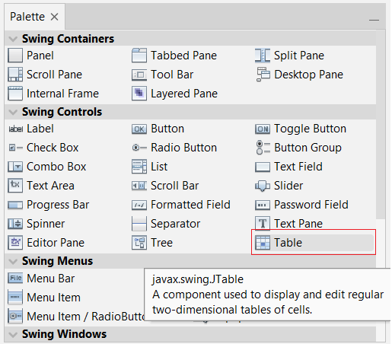
Display Data to jTable
Pada netbeans, jTable terletak pada kelompok SwingControl pada tab Palette

Slide 11
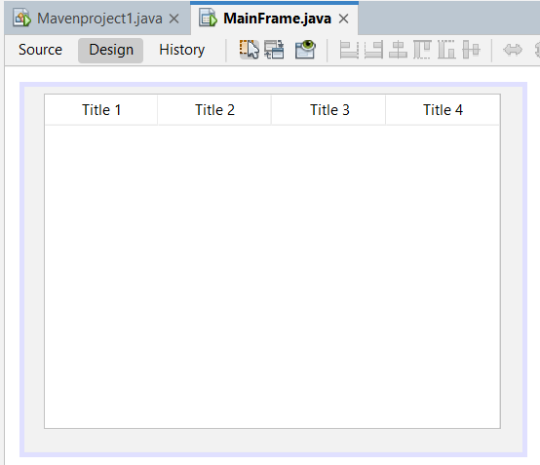
Display Data to jTable
By default, jTable will display 4 column like screenshot below

Slide 12
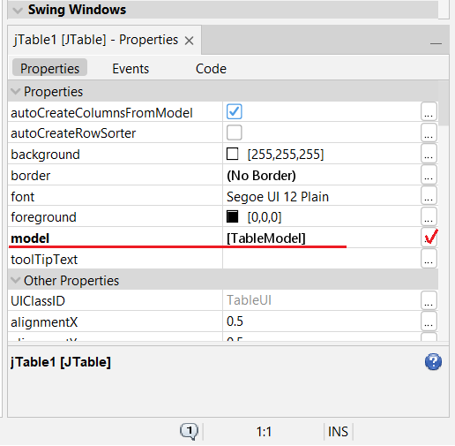
Display Data to jTable
Click on jTable then you will see jTable properties on right bottom on netbeans. Click on model to edit the display column

Slide 13
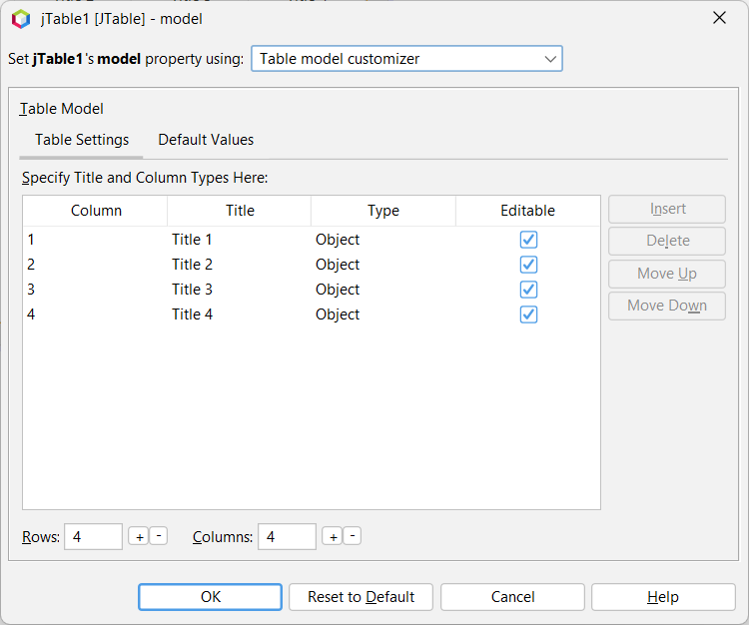
Display Data to jTable
Here you can edit display table on jTable

Slide 14
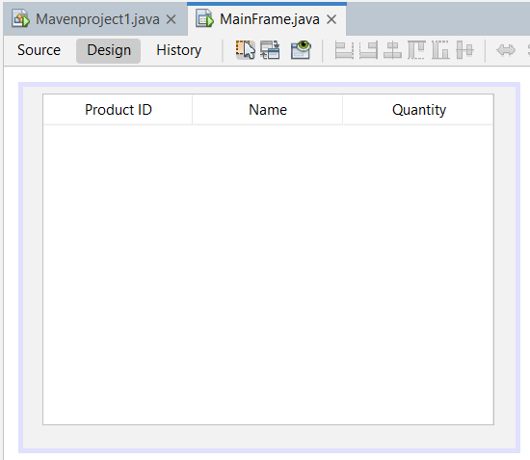
Display Data to jTable
Kekurangan: Jika pada suatu saat nanti ada perubahan nama kolom, maka harus meng-edit kembali. Solutions: gunakan ResultSetMetaData

Slide 15
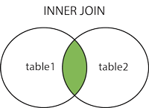
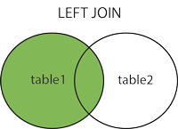
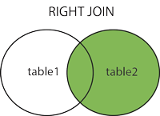
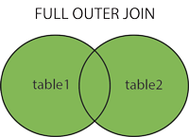
SQL Join and Optimization
4 kind of JOIN
Inner join
Left Join
Right Join
Full Outer Join (not available at MySQL)

Slide 16
Example
Employee ID | Name | Dept_id
E-1 | James Gosling | D-1
E-2 | Dennis M Ritchie | (null)
E-3 | Richard Anderson | D-2
E-4 | Bjarne Stroustrup | D-3
Dept_id | Name
D-1 | Human Resources
D-2 | Sales
D-3 | Data Center
D-4 | Network Managed Services

Slide 17
Inner Join
SELECT * FROM employee e, department d WHERE e.dept_id = d.dept_id
Employee ID | Name | Dept ID | Dept ID | Dept Name
E-1 | James Gosling | D-1 | D-1 | Human Resources
E-3 | Richard Anderson | D-2 | D-2 | Sales
E-4 | Bjarne Stroustrup | D-3 | D-3 | Data Center

Slide 18
Left Join
SELECT * FROM employee e LEFT JOIN department d ON e.dept_id = d.dept_id
Employee ID | Name | Dept ID | Dept ID | Dept Name
E-1 | James Gosling | D-1 | D-1 | Human Resources
E-2 | Dennis M Ritchie | (null) | (null) | (null)
E-3 | Richard Anderson | D-2 | D-2 | Sales
E-4 | Bjarne Stroustrup | D-3 | D-3 | Data Center

Slide 19
Right Join
SELECT * FROM employee e RIGHT JOIN department d ON e.dept_id = d.dept_id
Employee ID | Name | Dept ID | Dept ID | Dept Name
E-1 | James Gosling | D-1 | D-1 | Human Resources
E-3 | Richard Anderson | D-2 | D-2 | Sales
E-4 | Bjarne Stroustrup | D-3 | D-3 | Data Center
(null) | (null) | (null) | D-4 | Network Managed Services

Slide 20
Full Outer Join
SELECT * FROM employee e FULL OUTER JOIN department d ON e.dept_id = d.dept_id
Employee ID | Name | Dept ID | Dept ID | Dept Name
E-1 | James Gosling | D-1 | D-1 | Human Resources
E-2 | Dennis M Ritchie | (null) | (null) | (null)
E-3 | Richard Anderson | D-2 | D-2 | Sales
E-4 | Bjarne Stroustrup | D-3 | D-3 | Data Center
(null) | (null) | (null) | D-4 | Network Managed Services

Slide 21
Query Optimization
Query akan men-join table terlebih dahulu sebelum melakukan pengecekan pada WHERE condition
Performa query akan lebih optimal bila jumlah record pada table tersebut dapat direduksi terlebih dahulu

Slide 22
Thank you
Bayu Rimba Pratama, ST, M.Kom
bayuforest@gmail.com

